Slide 1



European Civil Protection Mechanism

Slide 2
Fundamentals of Civil Protection
Responsibility: Member States are responsible for the security and the safety of their citizens and foreigners on their territory.
Solidarity: Member States have the responsibility to support Member States affected by a disaster when needed. (re-enforced by Lisbon Treaty Solidarity Clause)
Call for assistance: Member States and third countries can call for assistance when overwhelmed by a disaster. After needs identification, they are responsible to receive / and for the use of EU/foreign assistance.
Voluntary: The level of support / assistance is determined by the Member State providing assistance.
Commission as facilitator: EU supports preparation, facilitates cooperation, coordination and complements MS. (Art. 196 Lisbon Treaty)

Slide 3
The EUCPM works on three main activities
1. Prevention: Support Participating States in preventing risks or reducing harm to people, the environment or property resulting from emergencies.
2. Preparedness: Training, exercises, exchanges of experts, modules.
3. Response: Facilitate cooperation and coordination in responding to disasters inside and outside the EU.

Slide 4
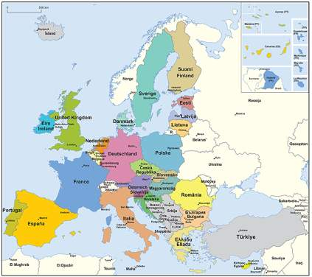
Union Civil Protection Mechanism
34 Participating States
EU Member States (27)
EEA – Norway, Iceland (2)
Former Yugoslav Republic of Macedonia, Montenegro, Serbia, Turkey (4)
United Kongdom
Open to candidate countries by Memorandum of Understanding (MoU), open to potential candidates; open to third countries by administrative cooperation agreements
Cooperation instrument (prevention, preparedness, response)

Slide 5
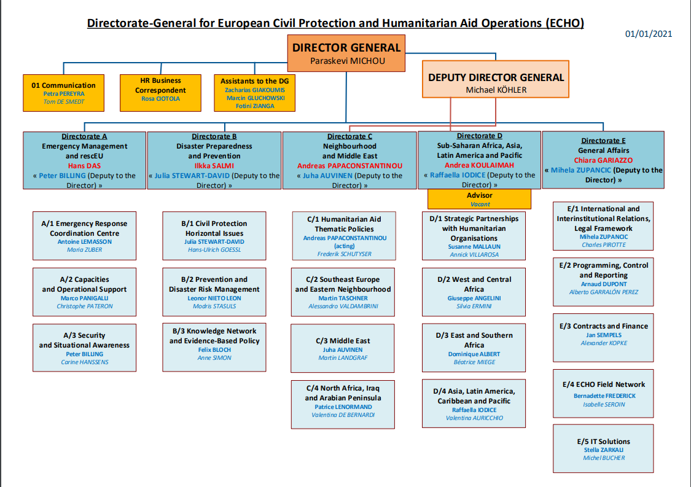

Slide 6
Pillars / Tools
Pillars / tools of the Union CP Mechanism
ERCC
CECIS
Transport support
Experts
Modules / TAST
Other Capacities
Training
Exercises
P&P
Lessons Learned

Slide 7
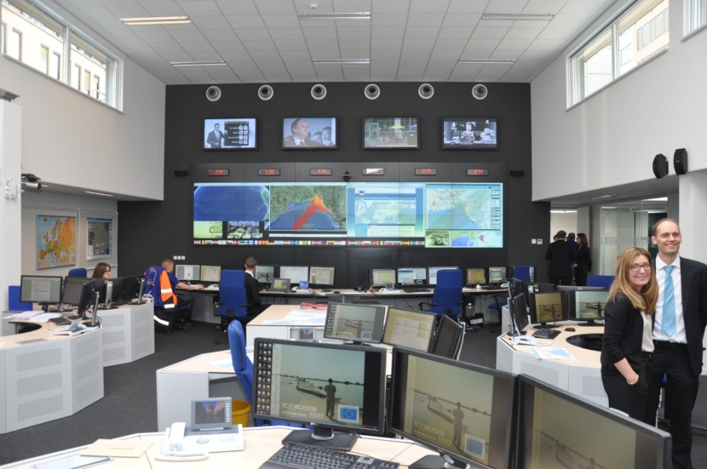
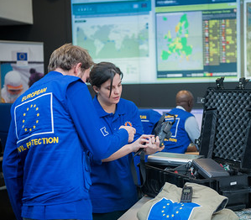
Emergency Response Coordination Center - ERCC

Slide 8
Emergency Response Coordination Center - ERCC
UCPM, emergency response 24/7 – main hat
IPCR 24/7 – the “other hat”
Solidarity Clause
ECURIE – radiological & nuclear
Copernicus EMS – satellite mapping
MEDEVAC with SANTE and WHO
ARGUS phase I

Slide 9
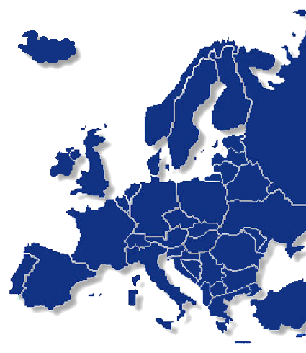
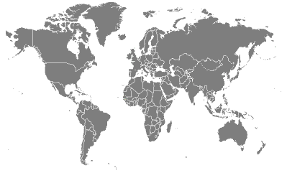



Disaster stricken country
Request for assistance
Acceptance / rejection of assistance offered
Information update
ERCC
Offer of assistance
Deployment of EU CP Teams
Coordination of Transport
Activation of the Mechanism

Slide 10
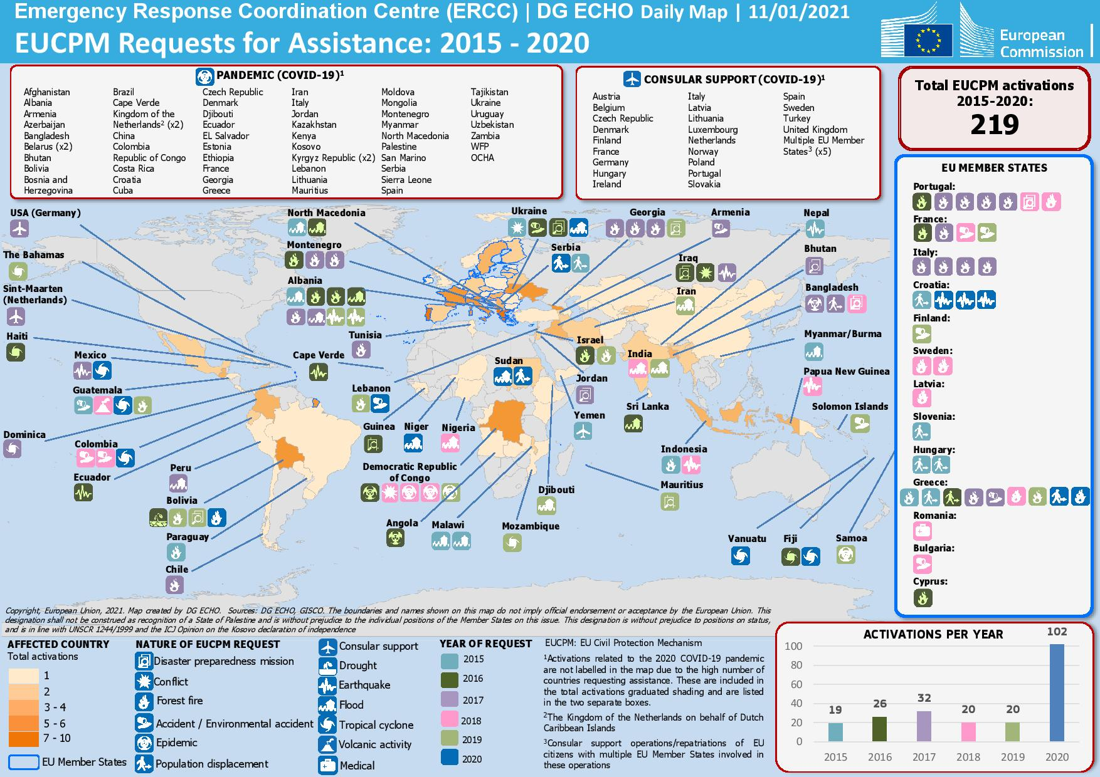

Slide 11
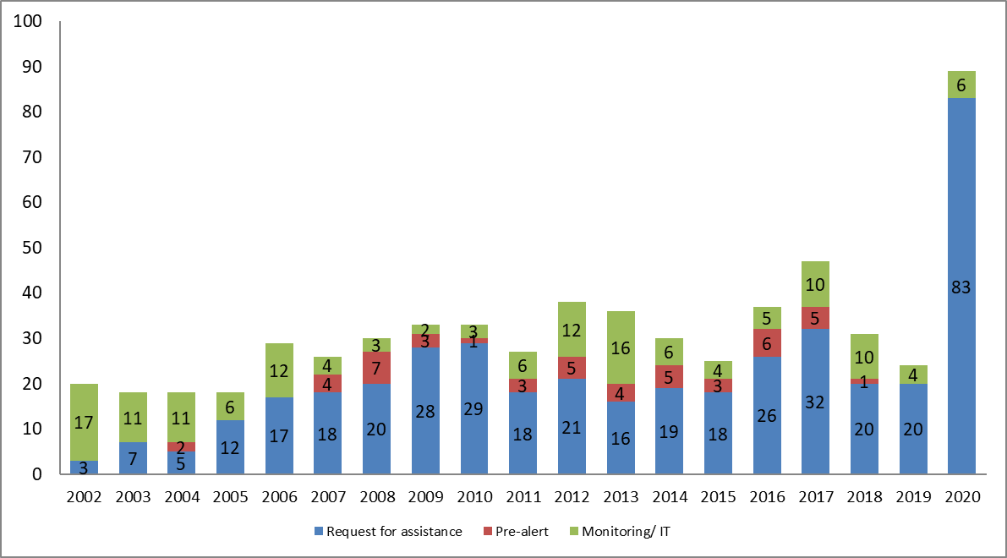
as of 12 July 2020

Slide 12
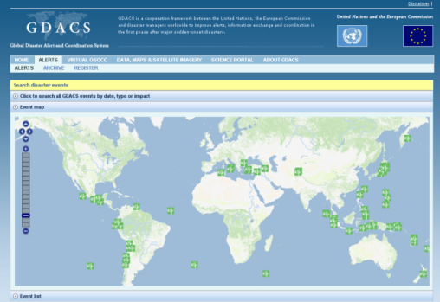
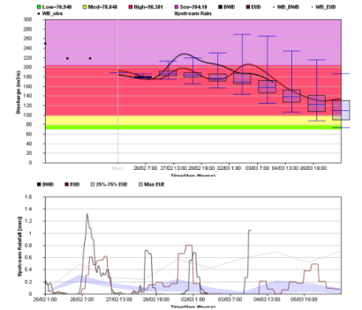
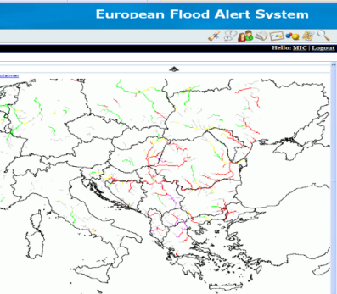
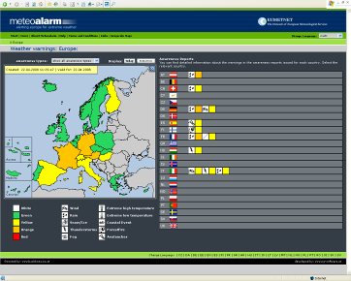

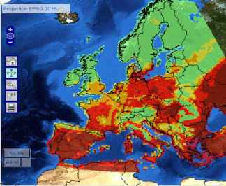
Monitoring tools
GDACS: Global Disaster Alert And Coordination System
EFAS - European Flood Awareness System: Floods forecasting and Flood alerts
EFFIS – European Forest Fire Information System: Fires forecasting
Weather monitoring

Slide 13
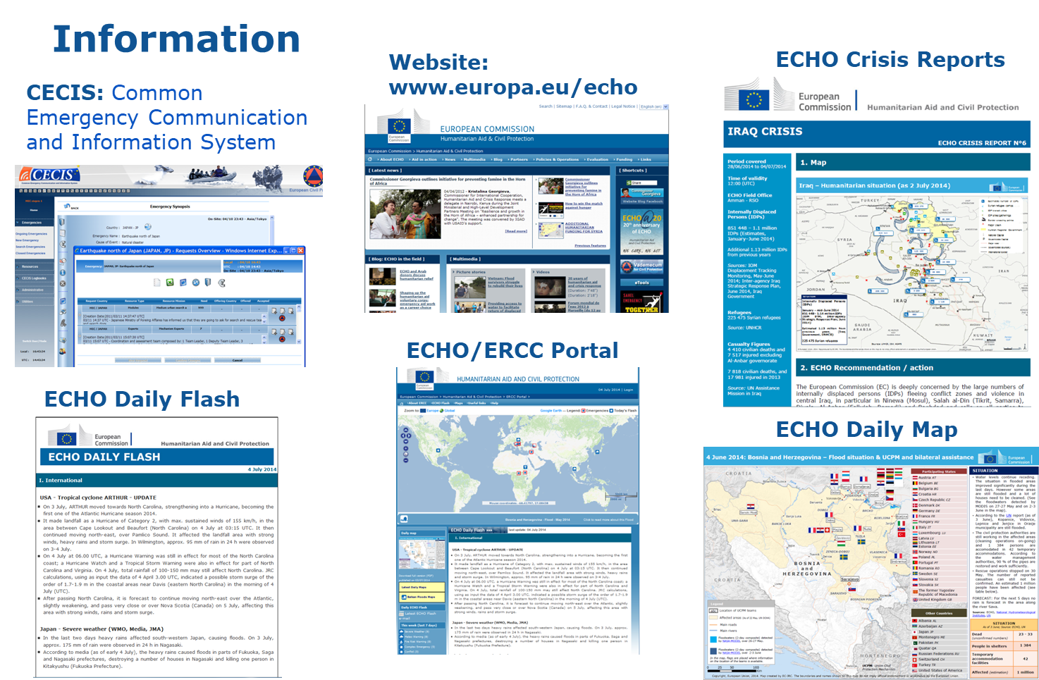

Slide 14
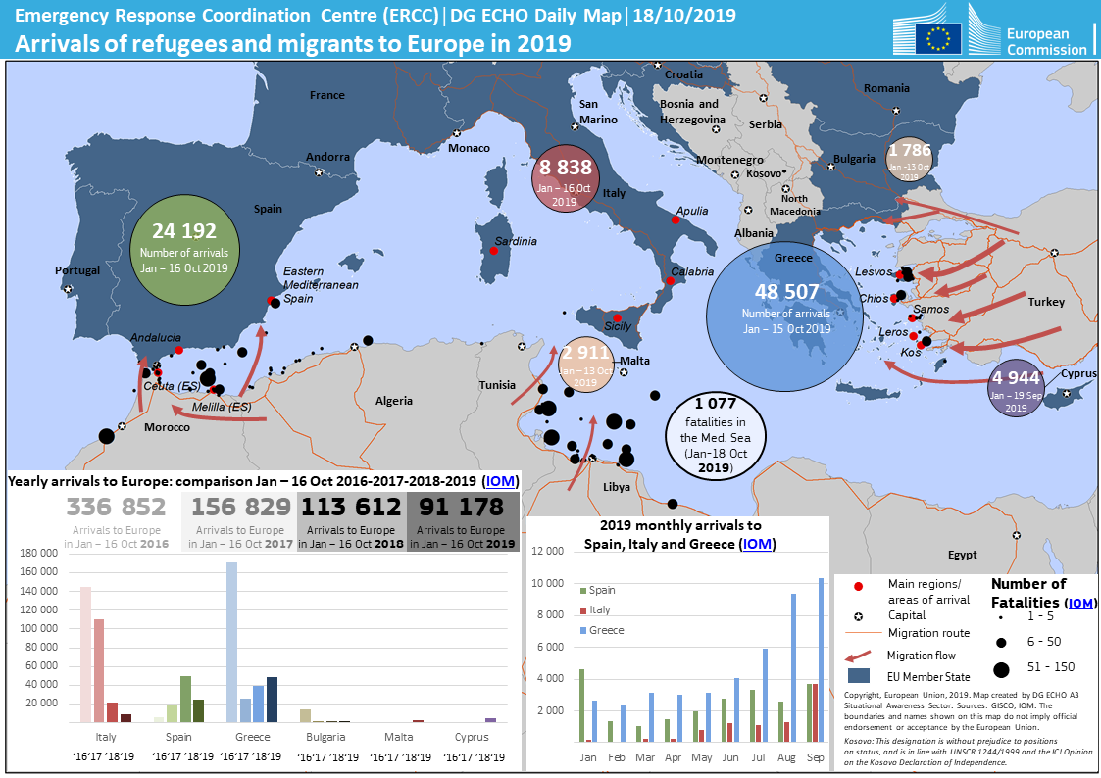

Slide 15

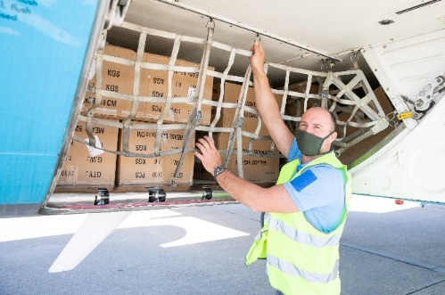
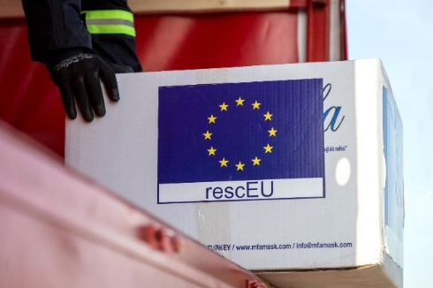
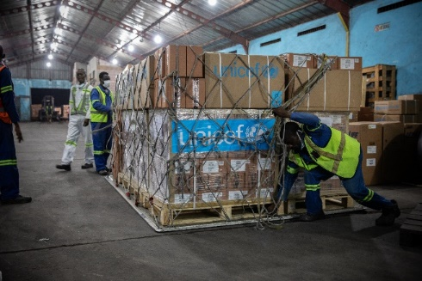
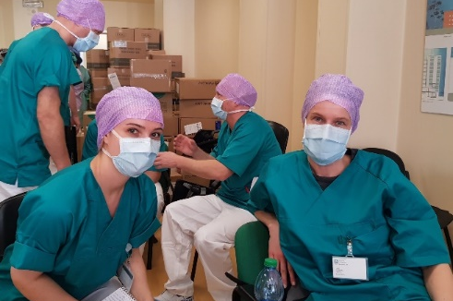
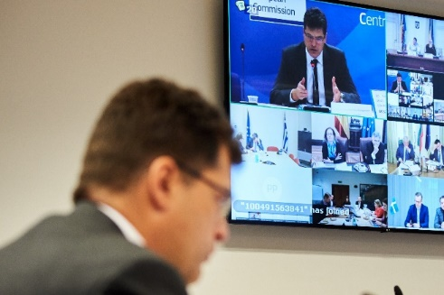
UCPM response for COVID-19
Repatriations
In-kind assistance
rescEU
Humanitarian cargo
Medical teams
Coordination

Slide 16
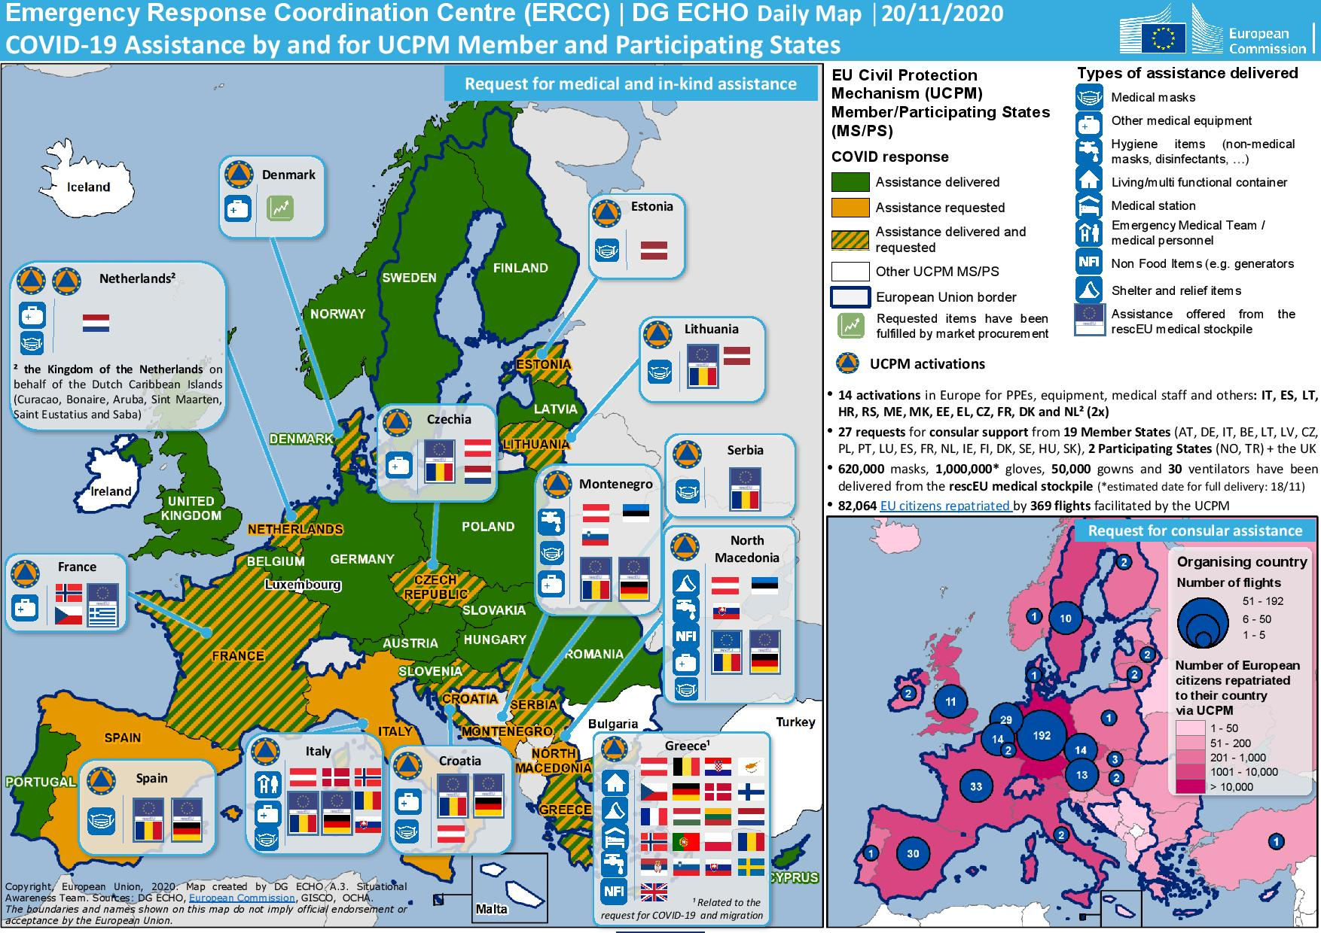

Slide 17
Training Programme
Online preparation
MODULES
All
TECHNICAL EXPERTS
INTRODUCTION
MBC
CMI
TEC/ TEC MI
OPERATIONAL
EU CPT members
ModTTEx
SMC
AMC
SME
OPM
ModEx
SEC
CND
MANAGEMENT
HLC

Slide 18
Definition of modules
Pre-defined and registered teams (human and technical means)
Self-sufficient and autonomous
Resources of one or more PS, on a voluntary basis
Perform tasks according to international guidelines
Can be dispatched in very short notice
Interoperable
Trained and exercised
General requirements for 17 modules defined

Slide 19
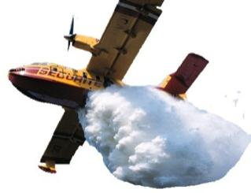
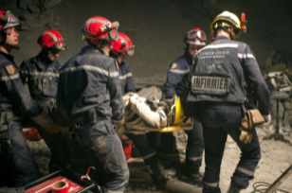
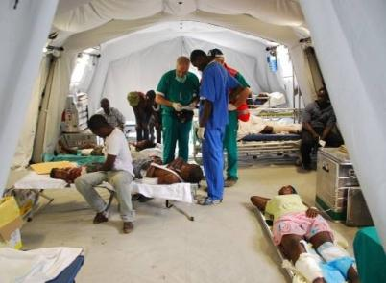
17 types of modules and 10 TAST registered by the PS
24 HCP (High capacity pumping),
5 WP (Water purification),
3 FFFP (Aerial forest fire fighting module using planes),
10 AMP (Advanced medical post),
4 AMPS (Advanced medical post with surgery),
4 MEVAC (Medical aerial evacuation of disaster victims),
30 MUSAR (Medium urban search and rescue – 1 equipped and trained for cold conditions),
12 HUSAR (Heavy urban search and rescue),
16 CBRNDET (CBRN detection and sampling),
5 CBRNUSAR (USAR in CBRN conditions),
2 FHOS (Field hospital),
1 ETS (Emergency Temporary Shelter),
7 GFFF (Ground forest fire fighting),
20 GFFF-V (Ground forest fire fighting using vehicles),
2 FC (Flood containment),
4 FRB (Flood rescue using boats),
10 TAST (Technical assistance and support team)

Slide 20
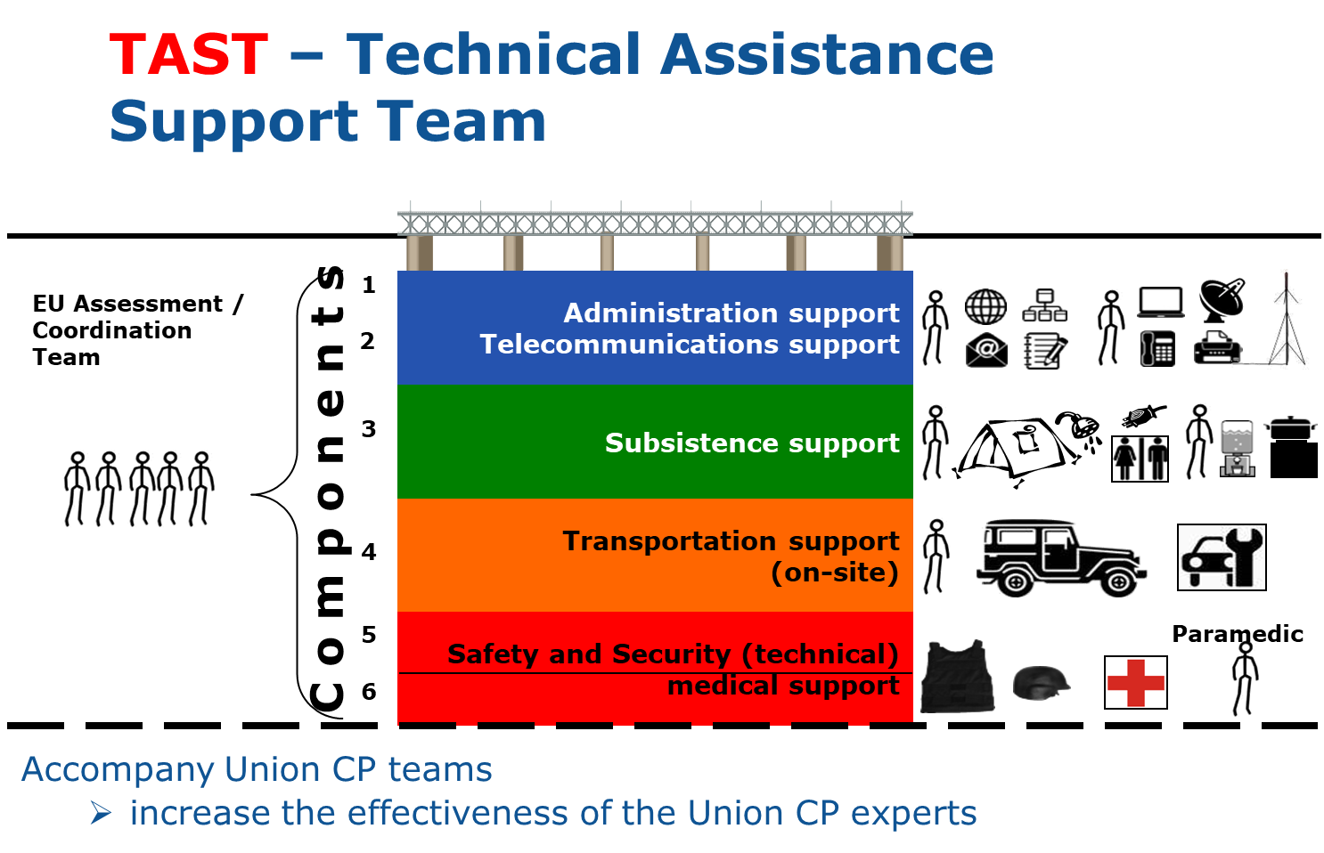

Slide 21
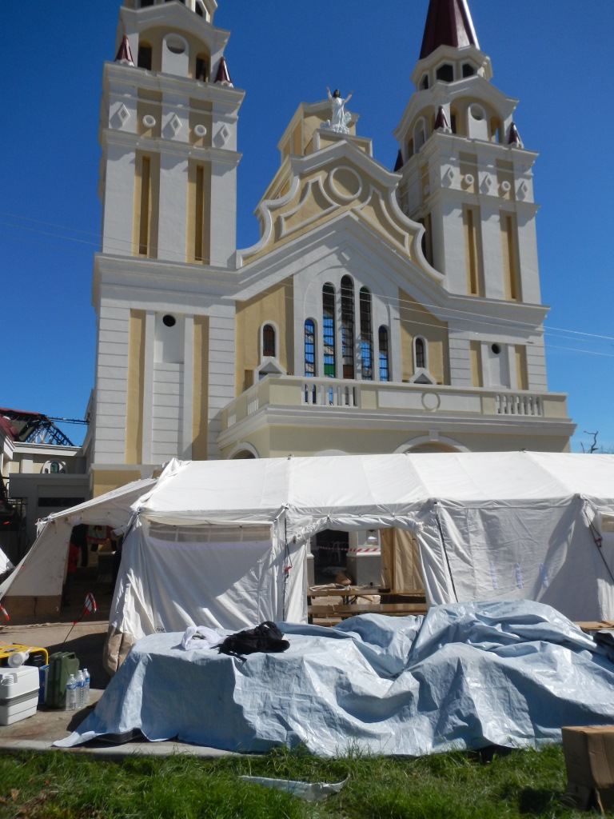
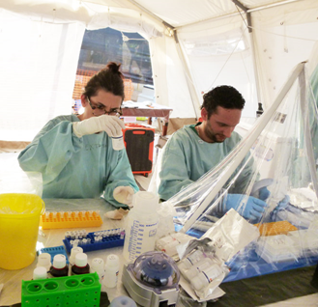
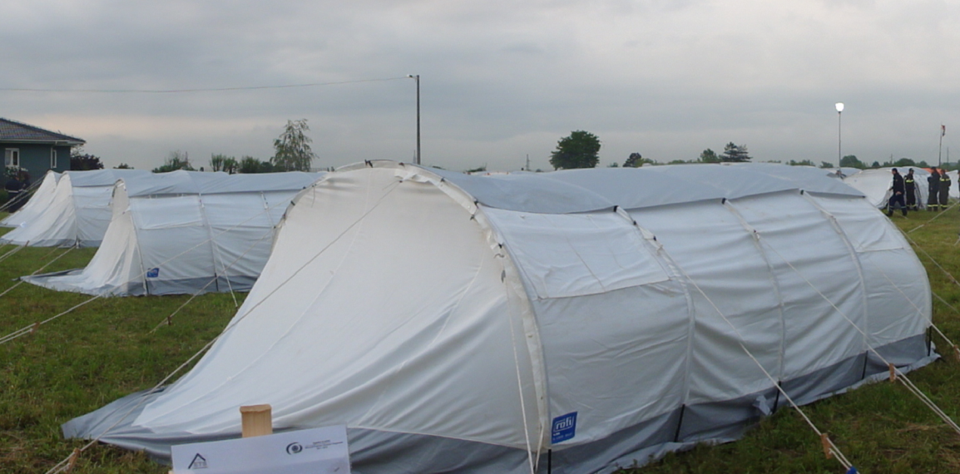
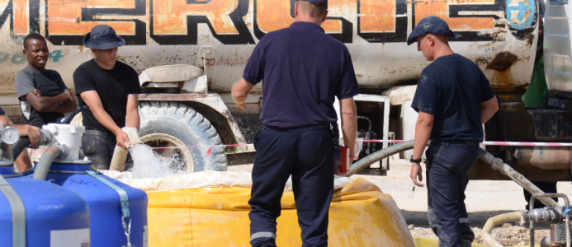
Capacities are registered in a voluntary pool of assets
Emergency Response Capacities
MOBILE HOSPITAL
MOBILE LAB
TEMPORARY SHELTER
WATER PURIFICATION

Slide 22
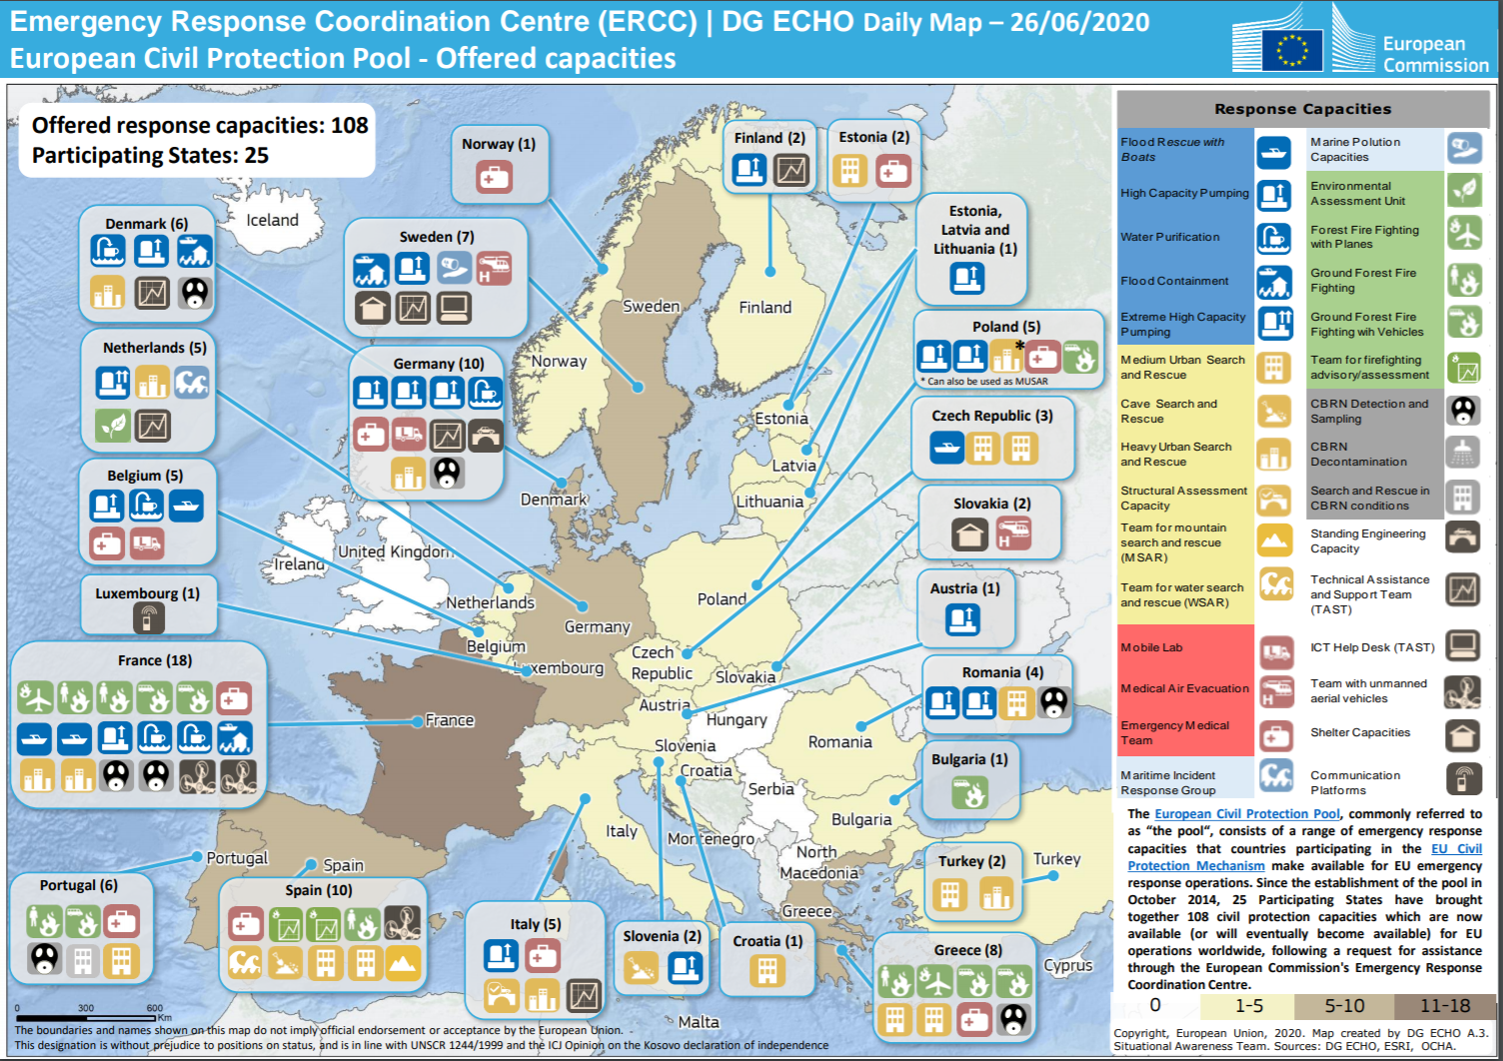

Slide 23
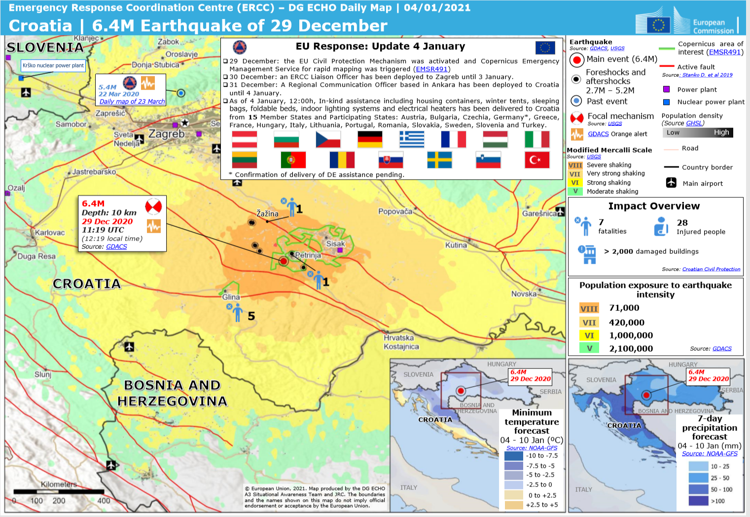

Slide 24
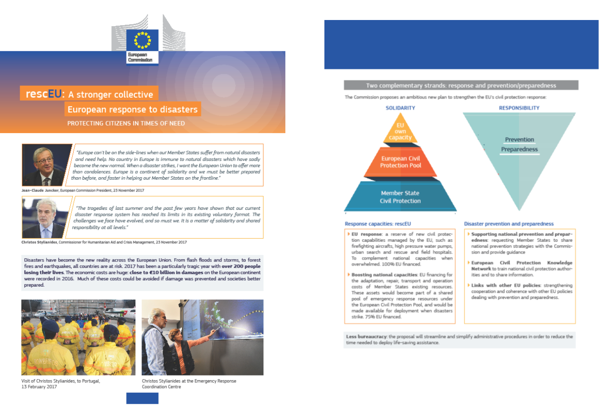
rescEU

Slide 25

rescEU
National capacities
European Civil Protection Pool or spontaneous offers
rescEU
Request for assistance through the ERCC
Safety net
Mutual assistance
First responders

Slide 26
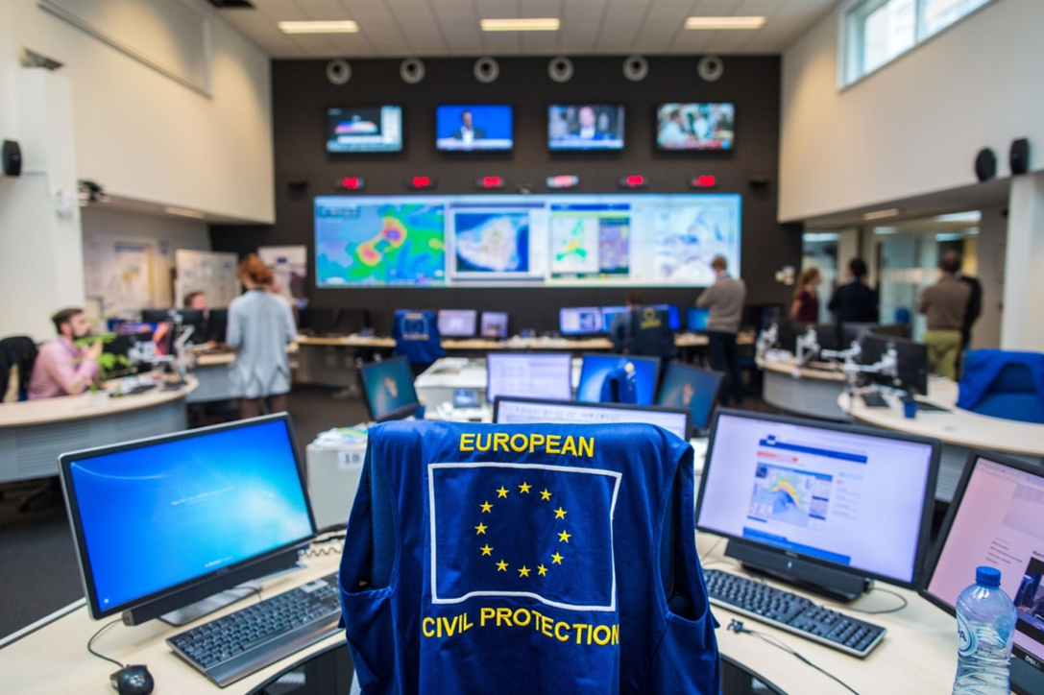
Thanks for your attention!

